Slide 1
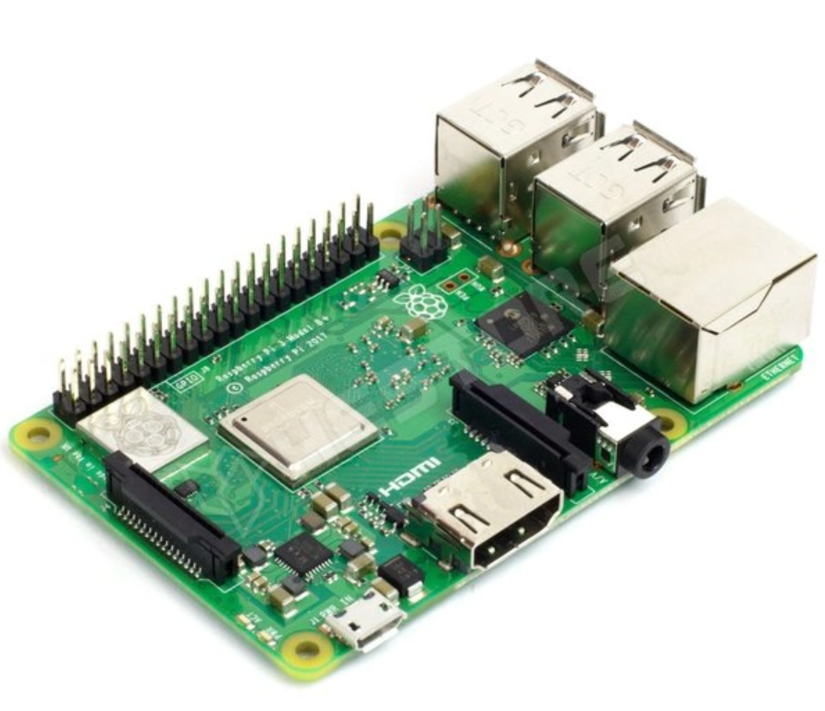
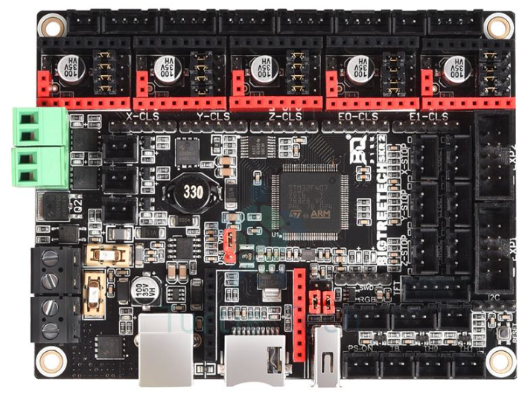
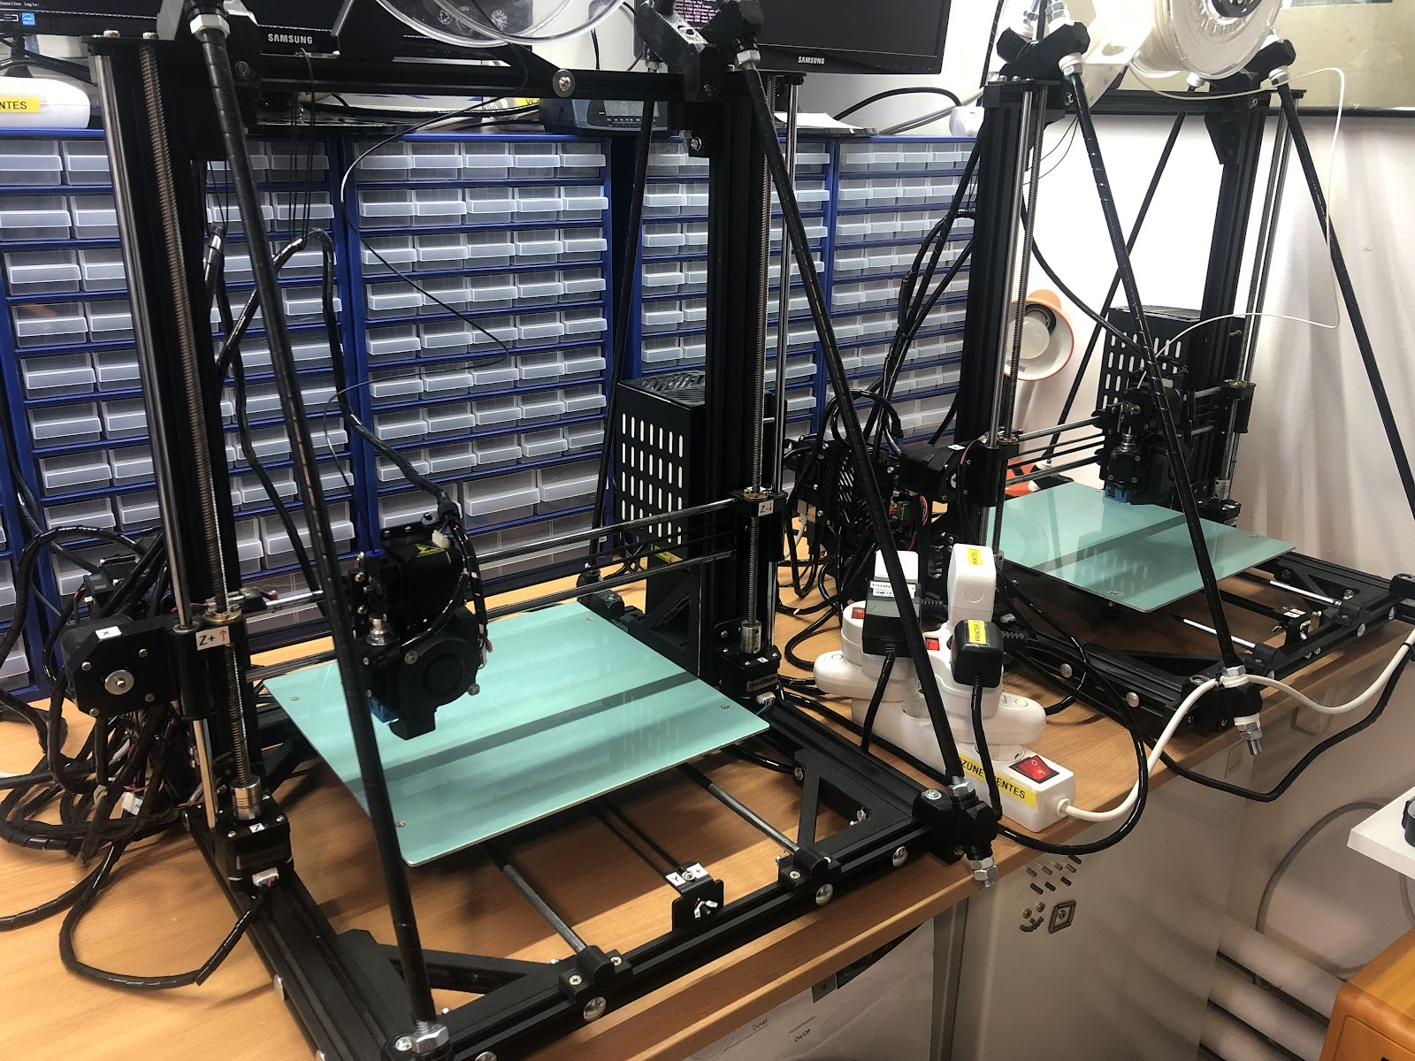
Upgrading Anet A8 Plus to Klipper with MainsailOS
Printer #1 with RPI3B+ & SKR2
Originally, Printer #1 was operating with Marlin firmware and OctoPrint. However, it frequently encountered issues with adhesion and temperature, which resulted in inconsistent and poor print quality. These issues often led to failed prints, and while the bed height calibration was regularly adjusted, this did not resolve the majority of the problems. The recurring issues were significantly impacting the overall reliability of the printer.
In contrast, Printer #2 had been operating smoothly and reliably for several years, using Klipper firmware paired with the Mainsail interface. Given the stability of Printer #2, it was decided to migrate Printer #1 to the same platform. After carefully separating the IP addresses and Raspberry Pi system names for both printers, Printer #1 was successfully transitioned to the Klipper-Mainsail setup. Following the migration, Printer #1 has been operating stably, showing no further issues with adhesion or temperature, and its performance has improved significantly.
Printer #2
Printer #1

Slide 2
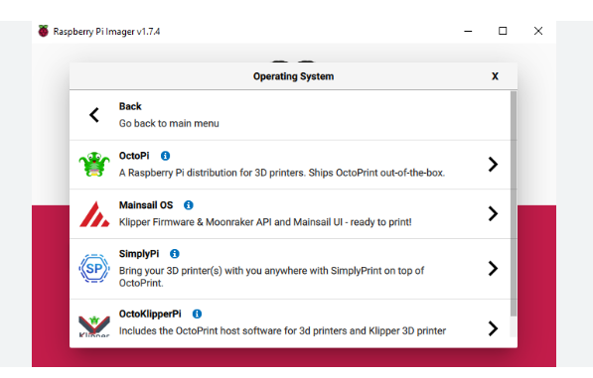
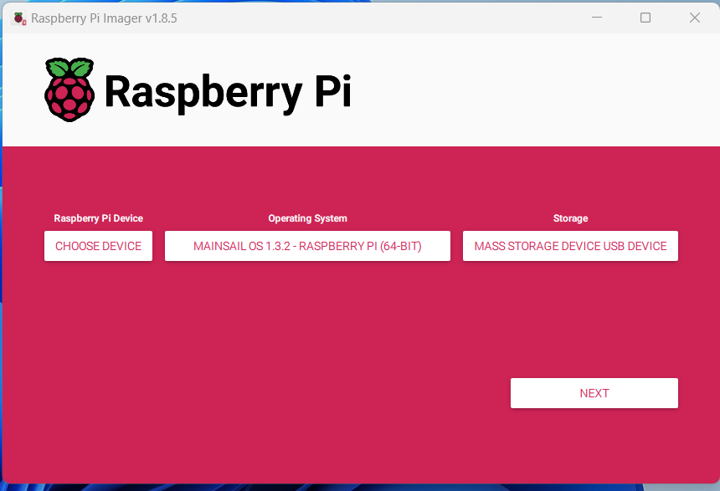
Upgrading Anet A8 Plus to Klipper with MainsailOS
Printer #1 with RPI3B+ & SKR2
Installation of MainsailOS on Raspberry 3B+ with raspberry imager, SD card needed.
->Other spec OS Mainsail 64 bit
Set wifi and password, hostname
Configuring Multiple 3D Printers on Mainsail? Raspberry Pi x2 and Mainsail x2

Slide 3
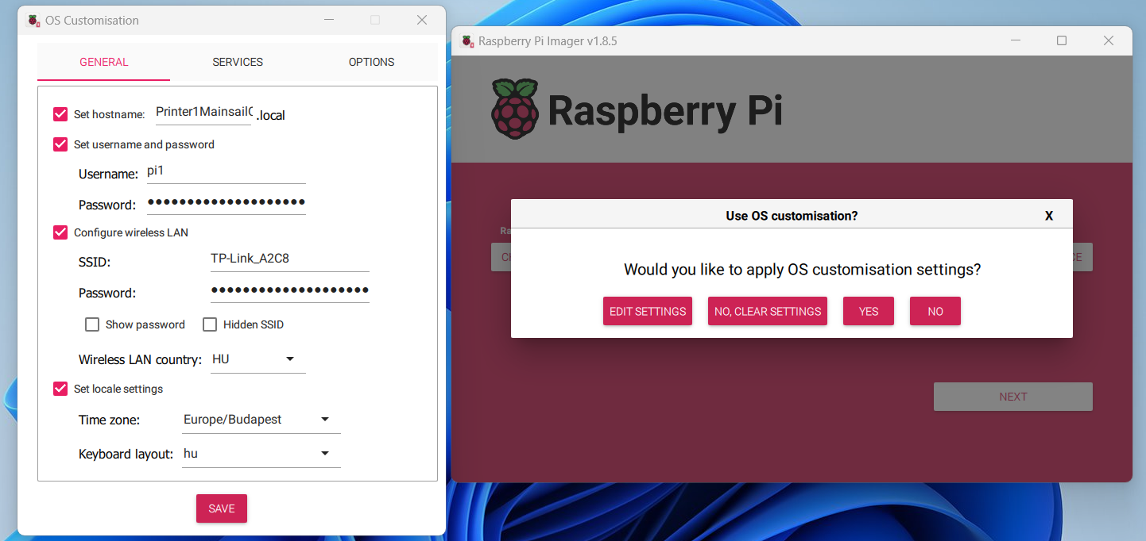
Upgrading Anet A8 Plus to Klipper with MainsailOS
Printer #1 with RPI3B+ & SKR2
Set wifi and password, hostname
Configuring Multiple 3D Printers on Mainsail? Raspberry Pi x2 and Mainsail x2

Slide 4
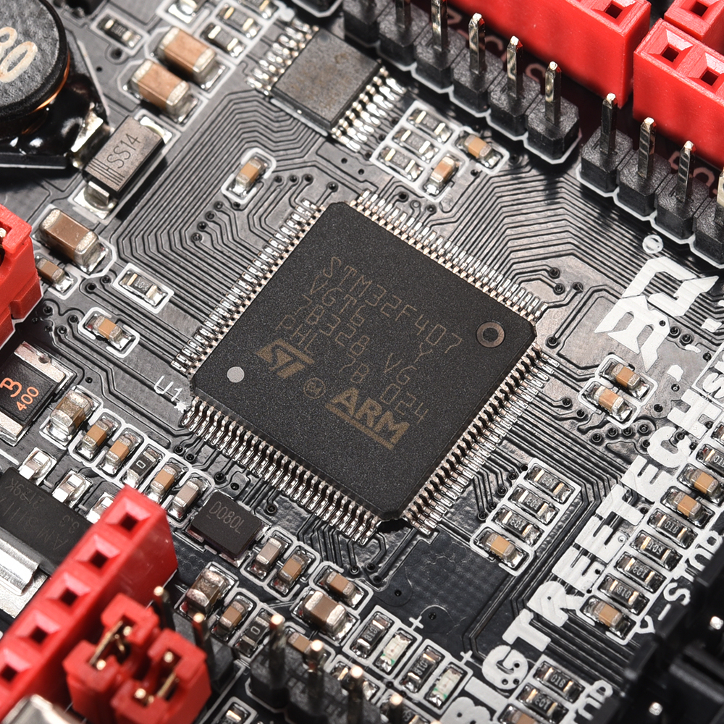
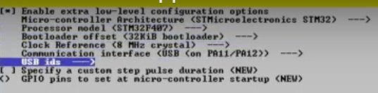
Upgrading Anet A8 Plus to Klipper with MainsailOS
Printer #1 with RPI3B+ & SKR2
Login to Raspberry 3B+ with pi1 and password
cd klipper
make menuconfig
Make -> klipper.bin file -> SKR2

Slide 5
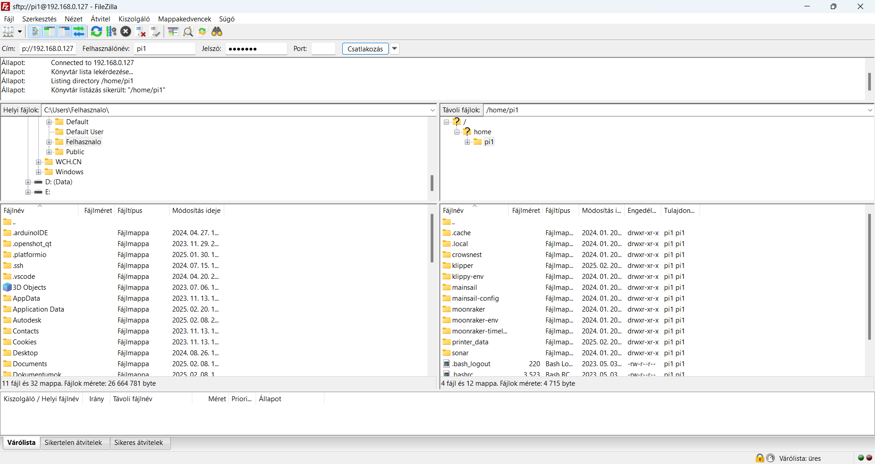
Upgrading Anet A8 Plus to Klipper with MainsailOS
Printer #1 with RPI3B+ & SKR2
Download FileZilla and connect to Raspberry 3B+
Rename Klipper.bin to firmware.bin and copy to SD card ->power on SKR2
Get firmware.cur if FW update is OK (SKR2 jumper need to be set to 5v mode of course)

Slide 6
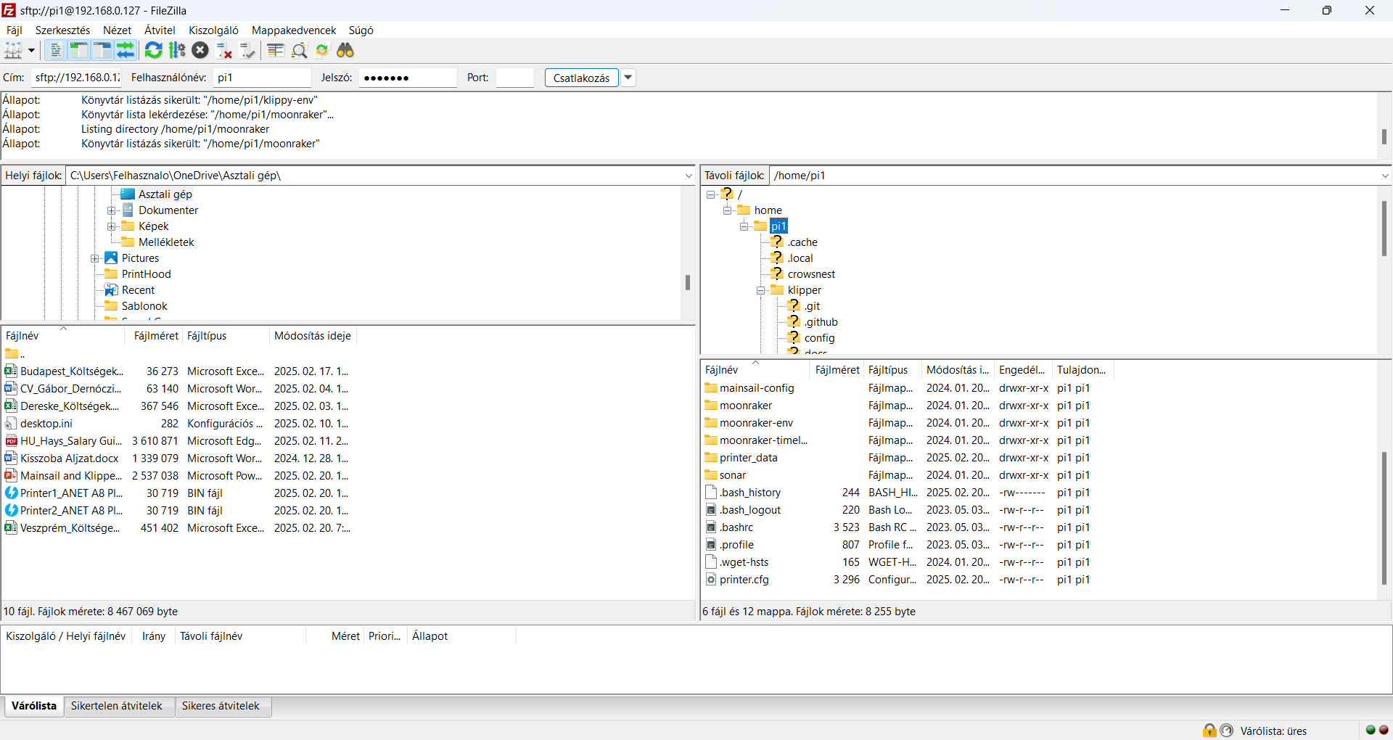
Upgrading Anet A8 Plus to Klipper with MainsailOS
Printer #1 with RPI3B+ & SKR2
FileZilla - Copy printer.cfg and upload to Mainsail

Slide 7
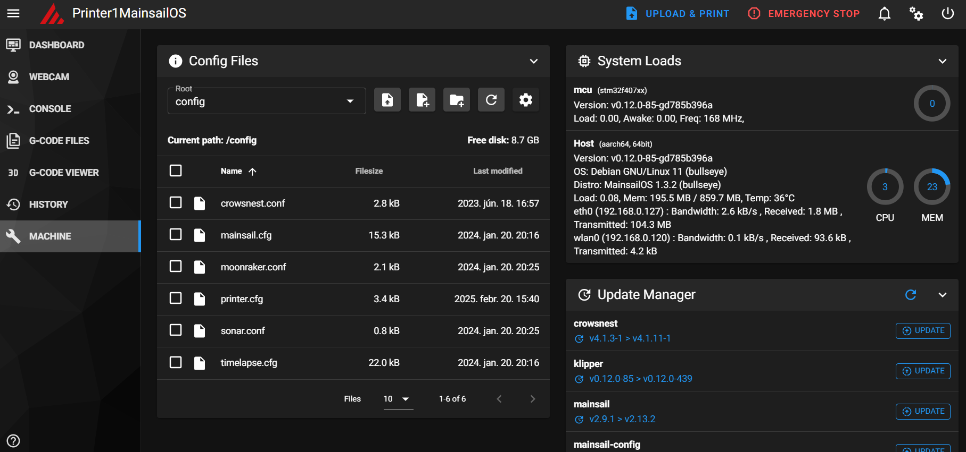
Upgrading Anet A8 Plus to Klipper with MainsailOS
Printer #1 with RPI3B+ & SKR2
Copy printer.cfg and upload to Mainsail

Slide 8
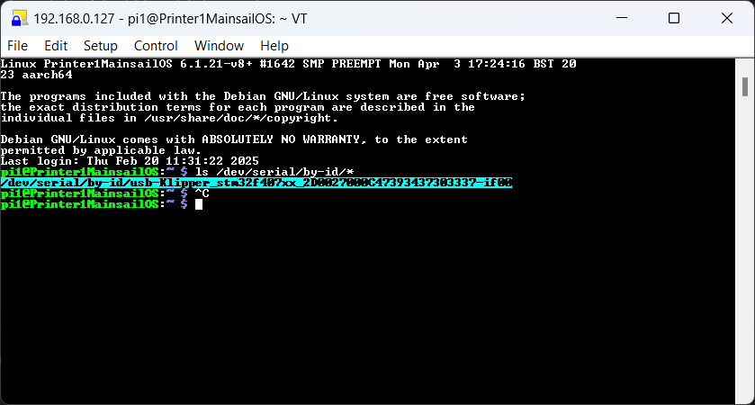
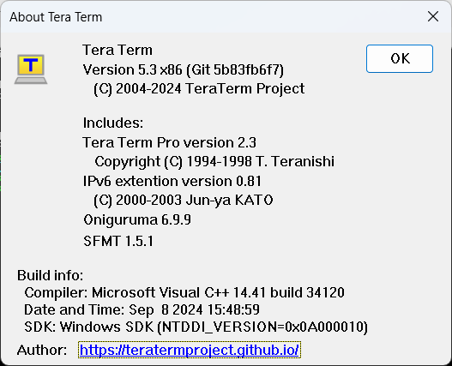
Upgrading Anet A8 Plus to Klipper with MainsailOS
Printer #1 with RPI3B+ & SKR2
Download Tera Term and -> host -> 192.168.0.127 -> pi1 and password
Get USB ID: ls /dev/serial/by-id/*
Release Tera Term 5.3 · TeraTermProject/teraterm

Slide 9
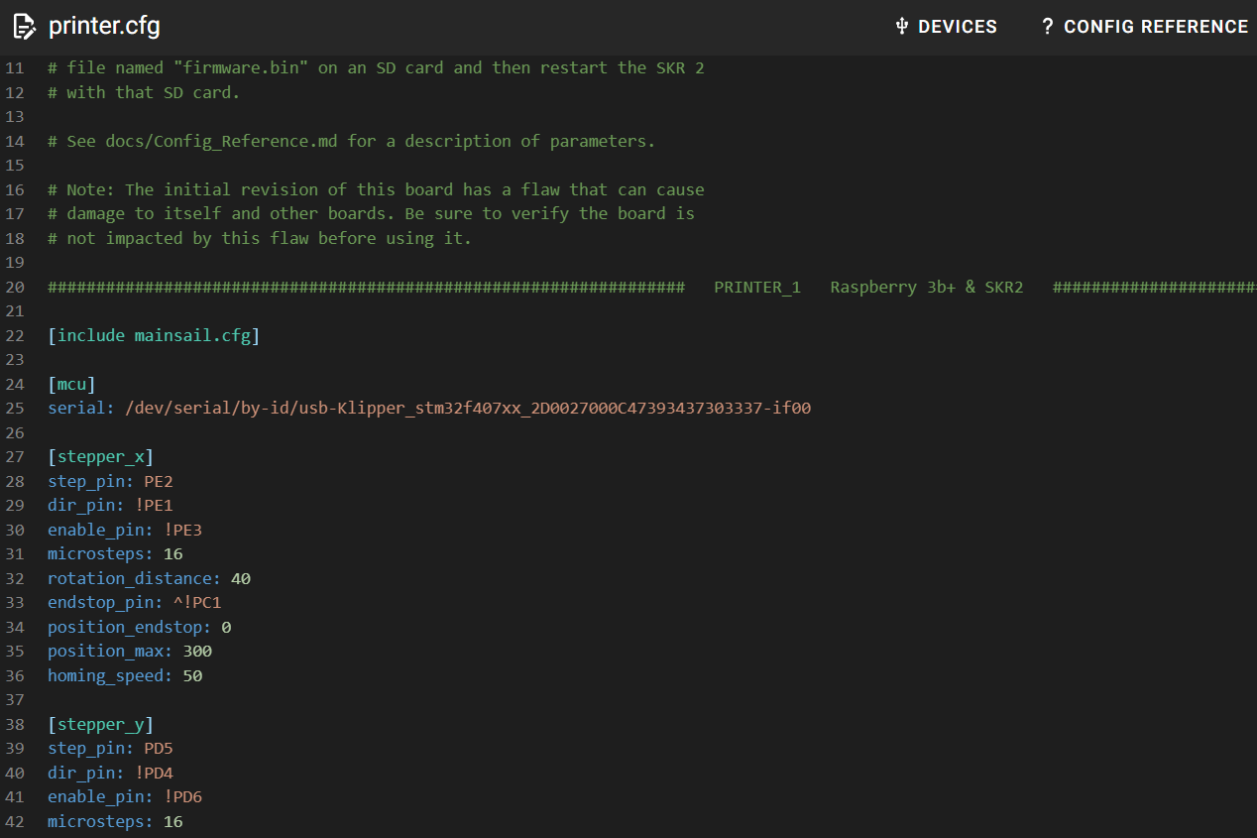
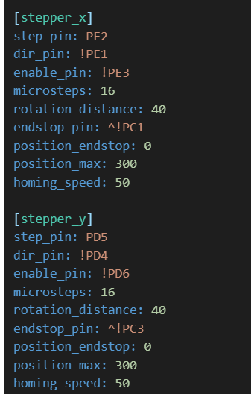
Upgrading Anet A8 Plus to Klipper with MainsailOS
Printer #1 with RPI3B+ & SKR2
Copy USB address into printer.cfg

Slide 10
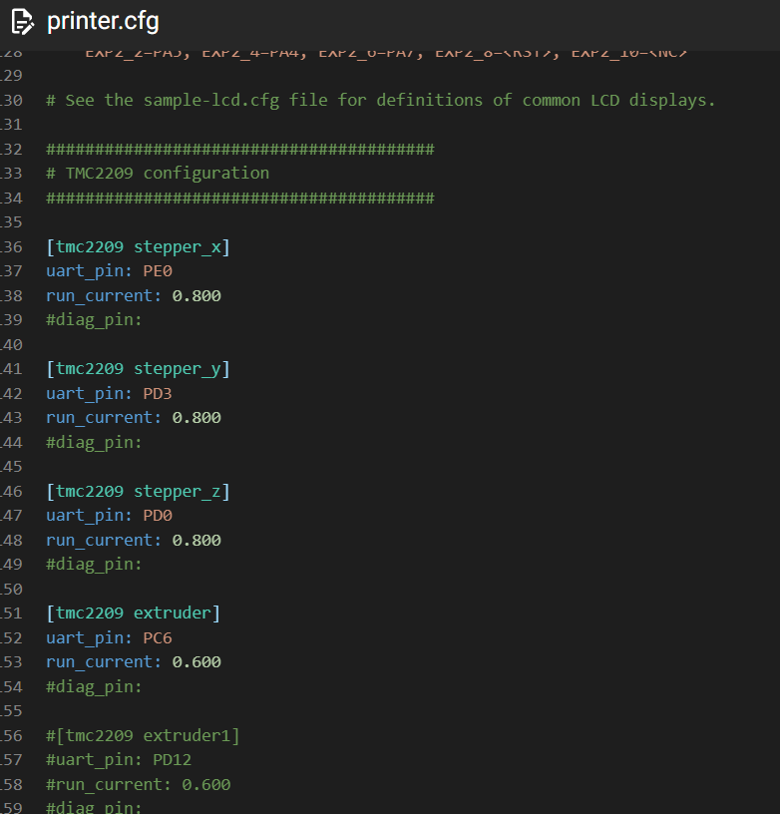
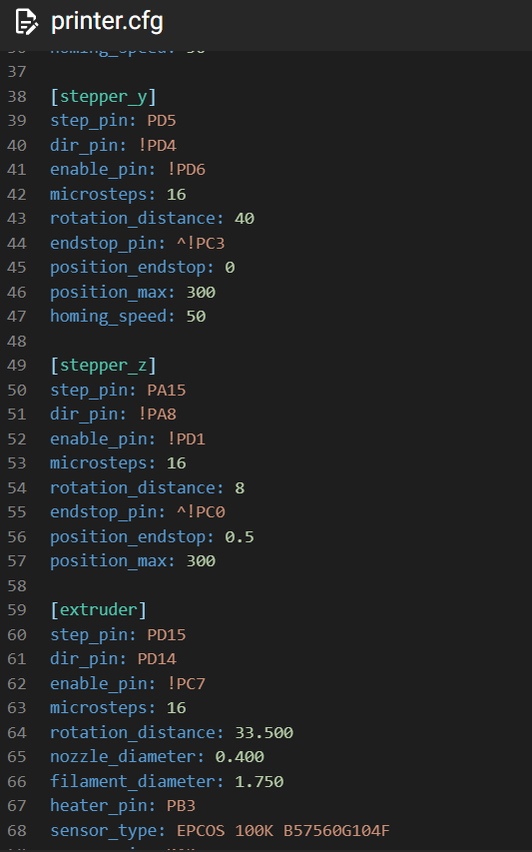
Upgrading Anet A8 Plus to Klipper with MainsailOS
Printer #1 with RPI3B+ & SKR2
Enable TMC2209 and set Z microsteps to 16 in printer.cfg

Slide 11
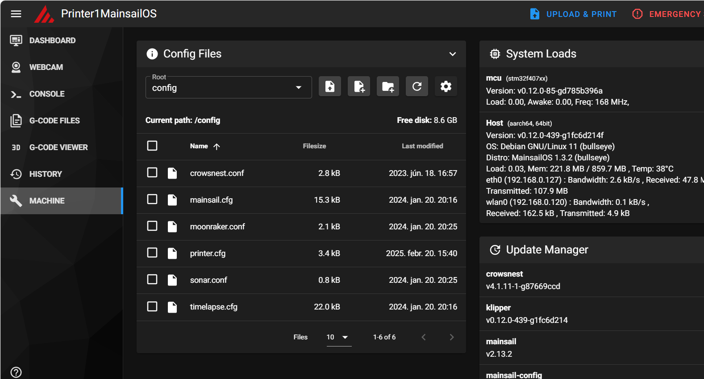
Upgrading Anet A8 Plus to Klipper with MainsailOS
Printer #1 with RPI3B+ & SKR2

Slide 12
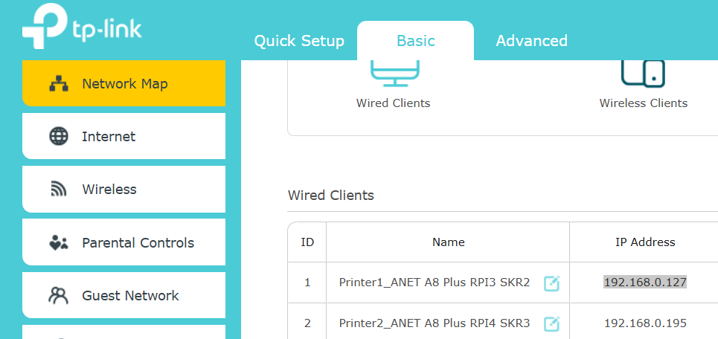
Upgrading Anet A8 Plus to Klipper with MainsailOS
Printer #1 with RPI3B+ & SKR2
Router status

Slide 13
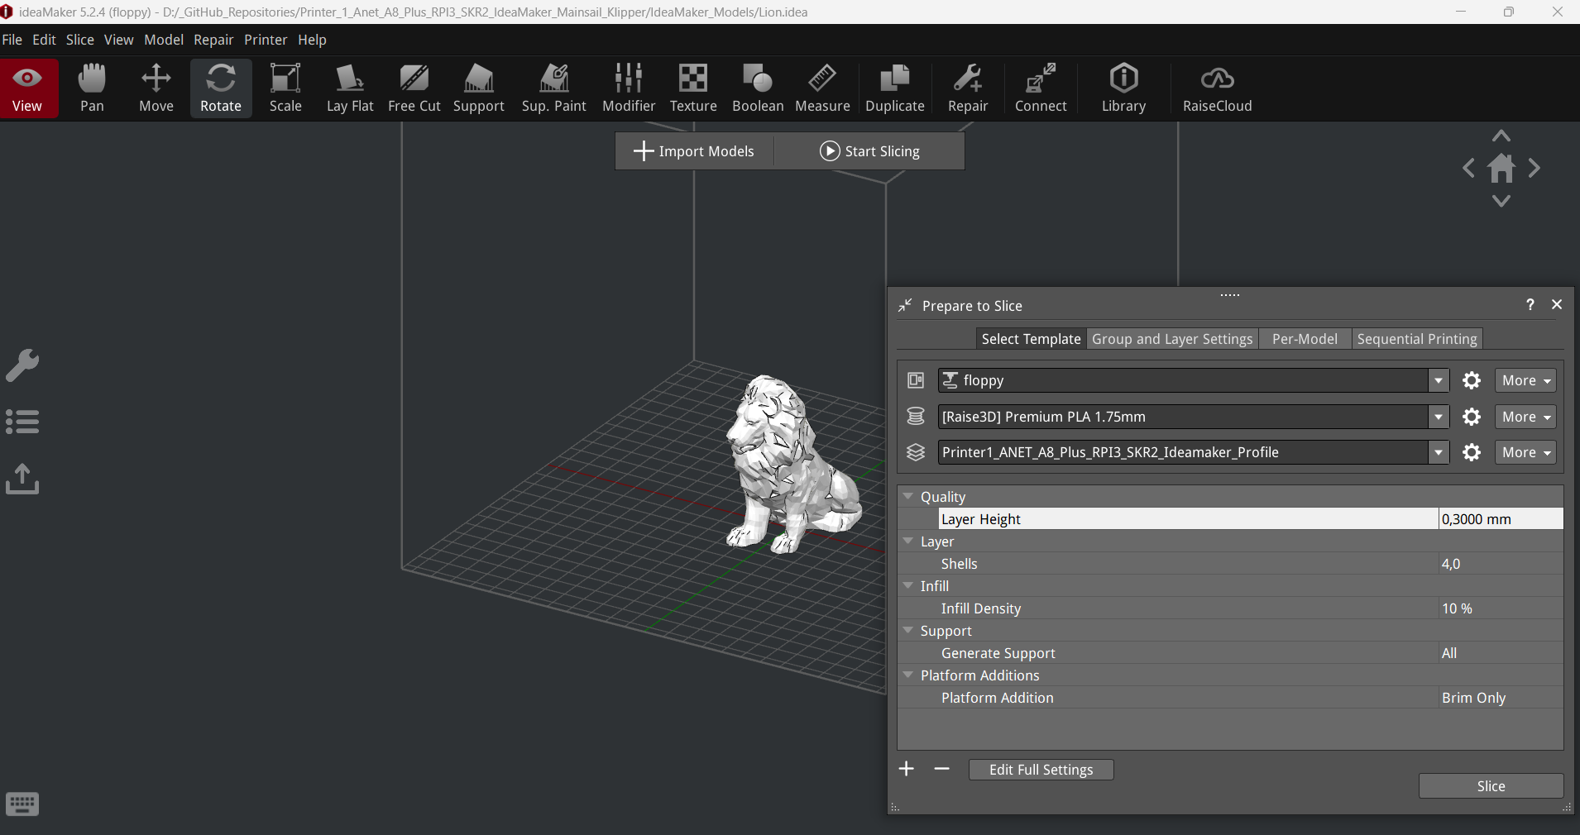
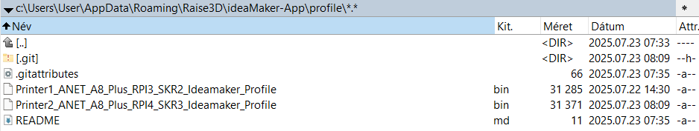
IdeaMaker Profile

Slide 14
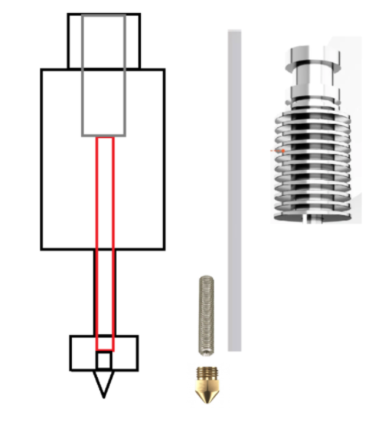
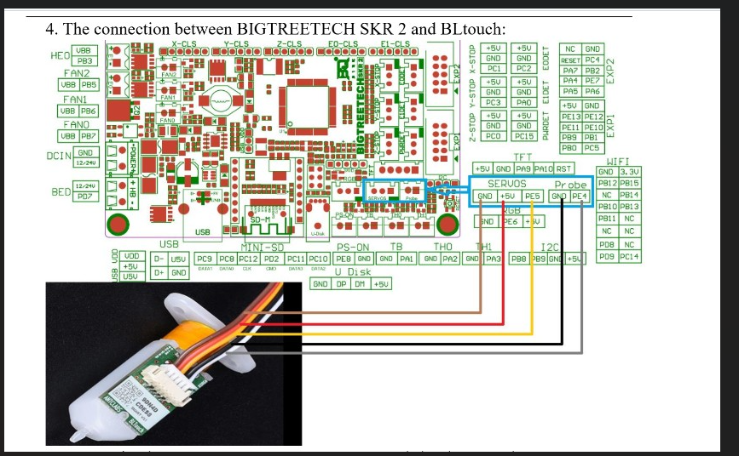

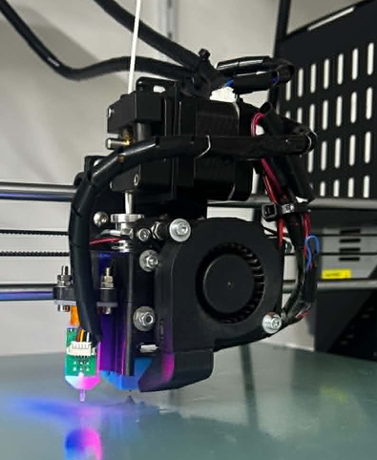

Upgrading Anet A8 Plus to Klipper with MainsailOS
Printer #1 with RPI3B+ & SKR2 & 3d touch
Individual solution of Volcano V6 Extruder

Slide 15
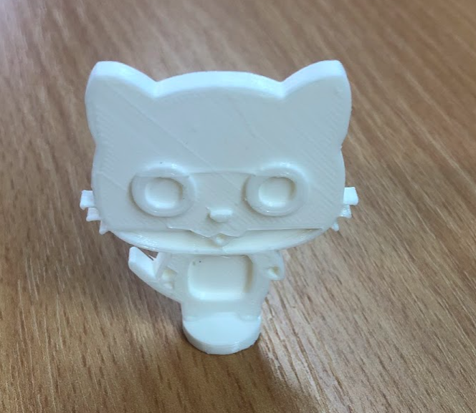
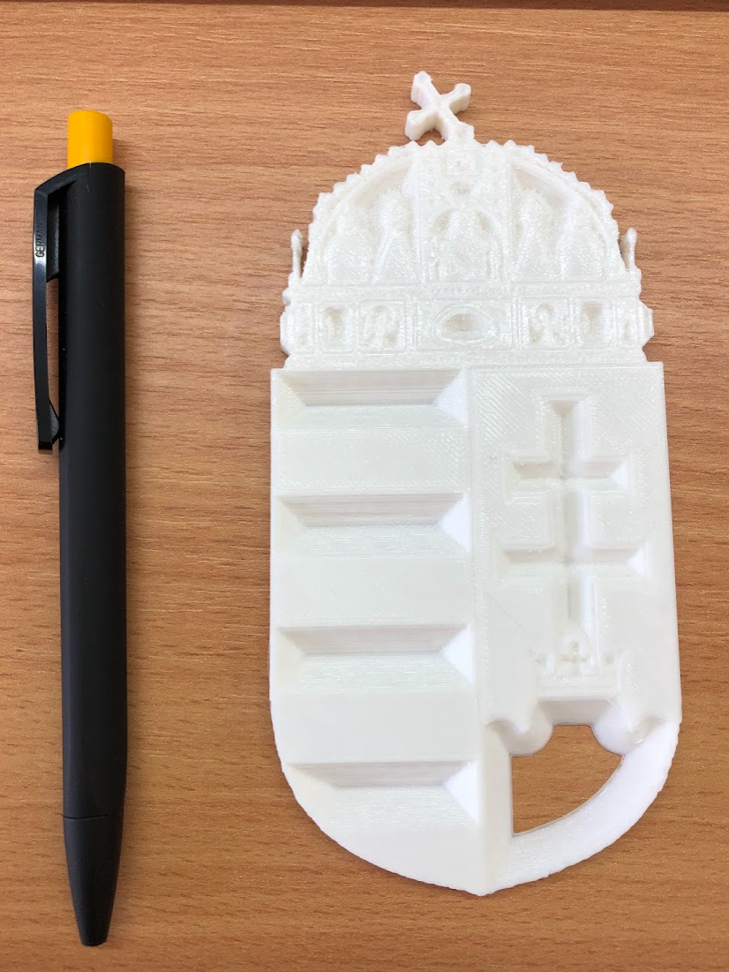
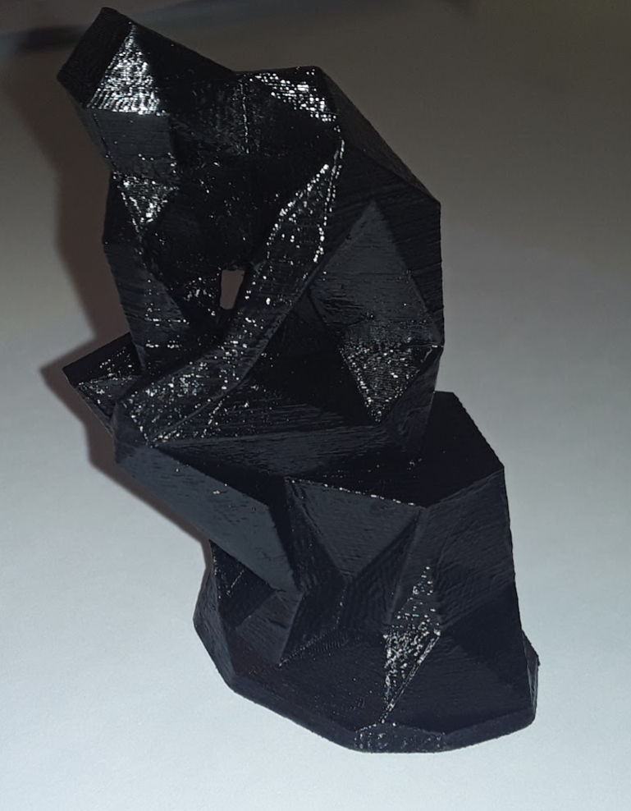
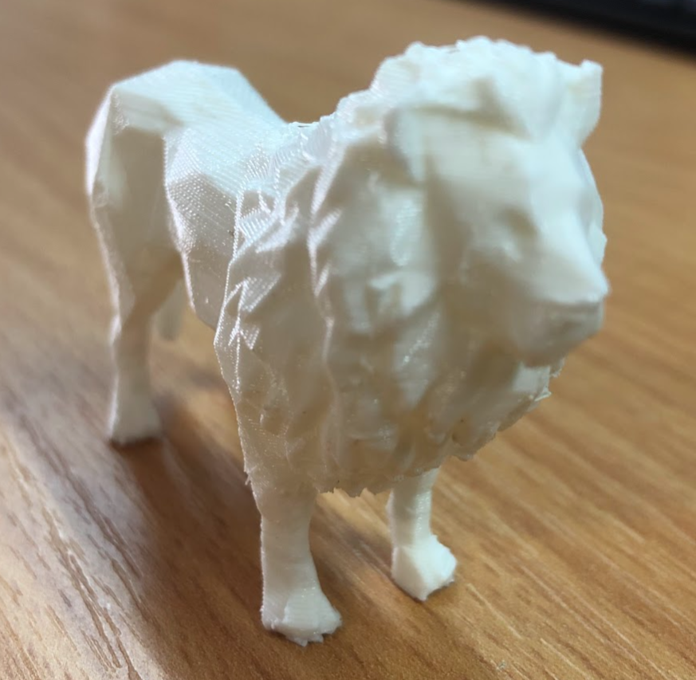

Upgrading Anet A8 Plus to Klipper with MainsailOS
Printer #1 with RPI3B+ & SKR2

